Slide 1

Vel Tech Rangarajan Dr. Sagunthala R&D Institute of Science and Technology
School of Computing
Department of Computer Science and Engineering
10211CS224 / FULL STACK APPLICATION DEVELOPMENT (JAVA)
END SEMESTER PROJECT REVIEW
Date: 06-05-2026
CAREER SYNC-JOB PORTAL
SDG: 9 – Industry, Innovation and Infrastructure
Presented By:
S.md.akram– VTU24476– 23UECS0882
Courses Handling Faculty:
Dr.Hemamalini.S
Assistance Professor

Slide 2
.
INTRODUCTION
1
• A Job Portal Management System is a web-based application designed to connect job seekers and employers on a single platform.
• It provides an easy-to-use interface where users can search, view, and apply for jobs online from anywhere.
• Employers can post job vacancies with details such as skills, experience, and salary, and manage applicants efficiently.
• The system helps users create professional profiles and upload resumes for better visibility.
• It reduces manual effort involved in traditional job searching and recruitment processes.
• Users can filter and search jobs based on category, location, skills, and experience level.
• The system maintains application status and provides real-time notifications.
• The system integrates REST APIs and third-party services for enhanced functionality.
2
3
4
5
6
7
8
9

Slide 3
PROBLEM STATEMENT
1
• Job recruitment processes are often manual, unorganized, and time-consuming, leading to delays in hiring.
• Job seekers need to visit multiple platforms and websites to find suitable job opportunities, which is inefficient.
• There is no proper system available to track job applications and monitor their current status.
• Employers struggle to manage and organize large numbers of applicants effectively.
• Lack of a centralized database leads to data mismanagement and difficulty in accessing information.
• It is difficult to filter candidates based on required skills, qualifications, and experience.
• There is no proper communication system between job seekers and employers for updates and notifications.
• There is a high risk of duplicate applications or missing application records in manual systems.
2
3
4
5
6
7
8
9

Slide 4
OBJECTIVE(S)
1
• To develop a web-based Job Portal Management System that connects job seekers and employers on a single platform.
• To simplify and automate the recruitment process with features like job posting, job search, application tracking, and secure access.
2
3
4
5
6
7
8
9

Slide 5
PROPOSED SYSTEM
1
The system is a web-based Academic Campus Event & Registration Portal.
It allows students to securely register and log in to view available events.
Students can register for events with duplicate prevention and deadline validation.
Admin can log in separately to manage and monitor all event registrations.
The system automatically stores and manages data in a centralized database.
Real-time registration reports are generated for both students and admin.
The portal improves transparency and reduces manual errors.
It ensures secure, efficient, and organized event management.
2
3
4
5
6
7
8
9

Slide 6
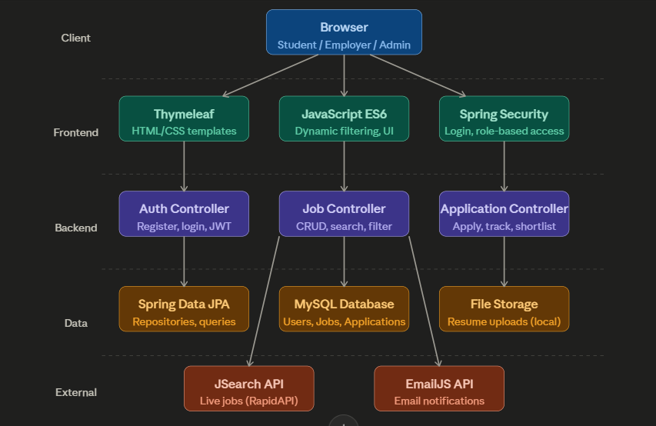
PROPOSED SYSTEM ARCHITECTURE
1
2
3
4
5
6
7
8
9

Slide 7
PROPOSED SYSTEM ARCHITECTURE
1
Input:
User registration details, login credentials, job postings, resume uploads, and job applications.
Processing:
User authentication, job search and filtering, REST API handling, application submission, validation, and status tracking.
Database:
Stores user details, employer details, job listings, applications, and resume files.
External APIs:
JSearch API is used to fetch live job listings.
EmailJS API is used to send automated email notifications.
Output:
Job listings, application status updates, notifications, dashboards, and reports.
2
3
4
5
6
7
8
9

Slide 8
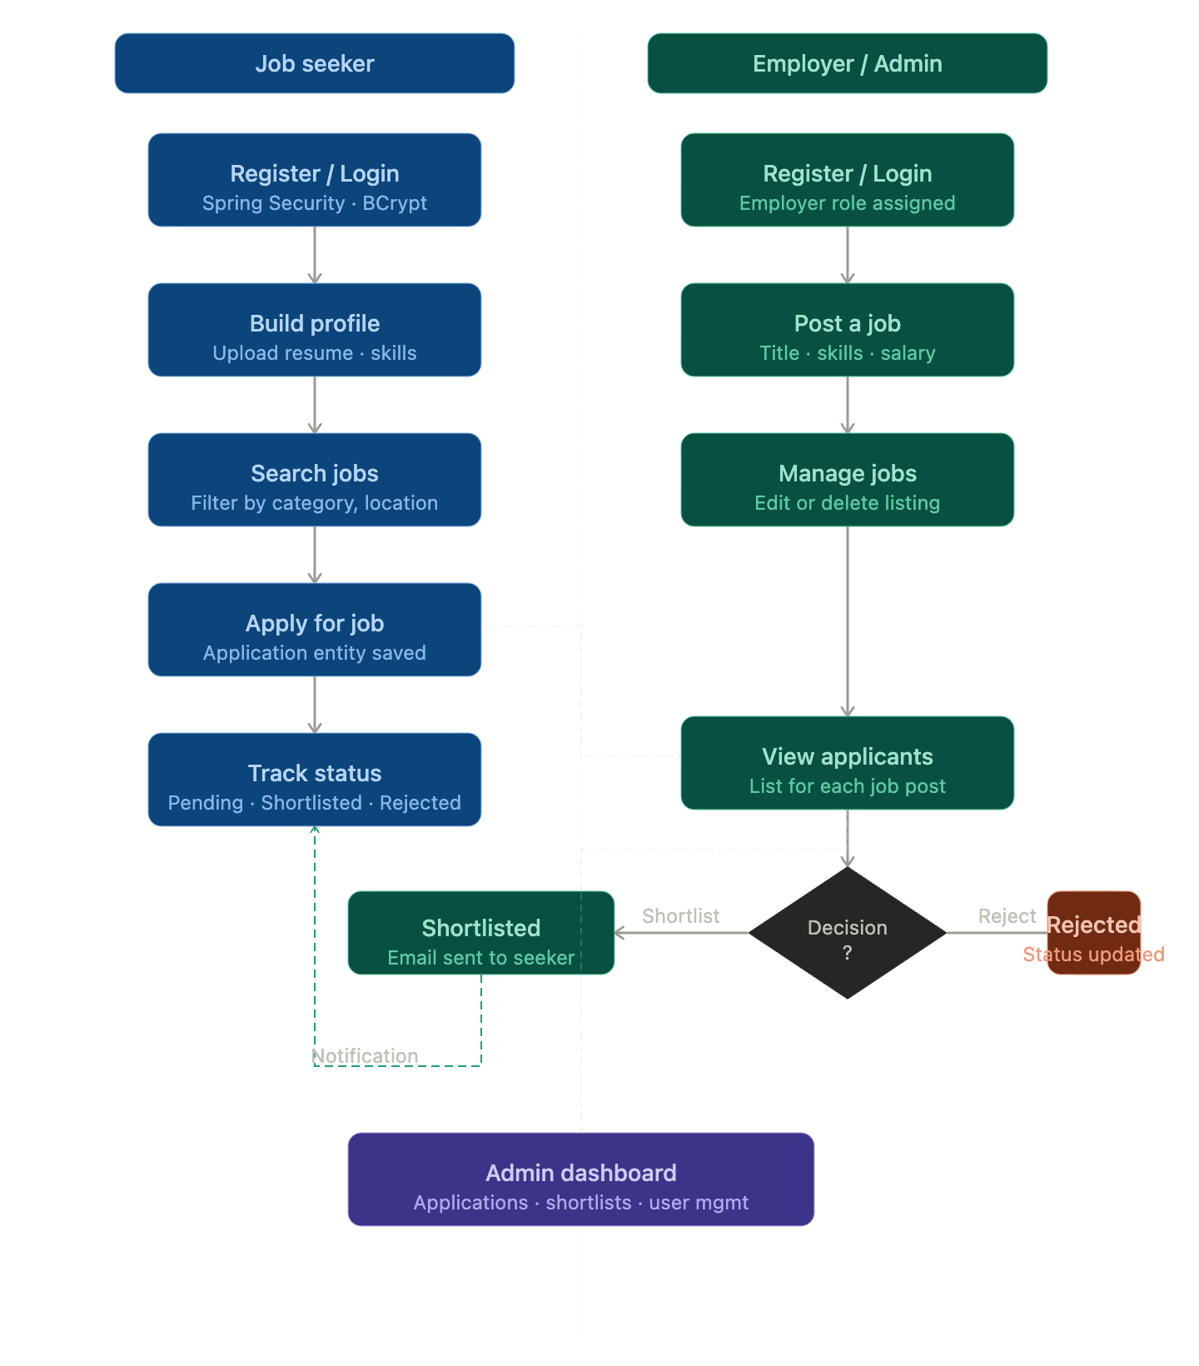
WORKFLOW
1
2
3
4
5
6
7
8
9

Slide 9
TECHNOLOGIES USED
Frontend:
- HTML, CSS, JavaScript, Thymeleaf
Backend:
- Java, Spring Boot, Spring MVC
- REST API (Spring Boot REST Controllers)
Database:
- MySQL
Third-Party APIs:
- EmailJS (for sending email notifications)
- JSearch API (for fetching live job listings)
Tools:
- Visual Studio Code
- MySQL Workbench
- Spring Initializer
Hardware/Software Requirements:
- Minimum 4GB RAM
- JDK 8 or above
- Web Browser (Chrome)
1
2
3
4
5
6
7
8
9

Slide 10
MODULE DESCRIPTION
Module 1: Job Seeker (User) Module
Handles user registration, login, profile creation, resume upload, job search, and applying for jobs.
Module 2: Employer Module
Allows employer login, posting job vacancies, managing job listings, and viewing applicants.
Module 3: Job Management Module
Manages job details, job updates, filtering, searching, and deletion of job postings.
Module 4: Application Management Module
Handles job applications, application tracking, status updates, and shortlist/reject process.
Module 5: API & Notification Module
Handles integration with external APIs:
- EmailJS for sending automated notifications
- JSearch API for fetching real-time job listings
1
2
3
4
5
6
7
8
9

Slide 11
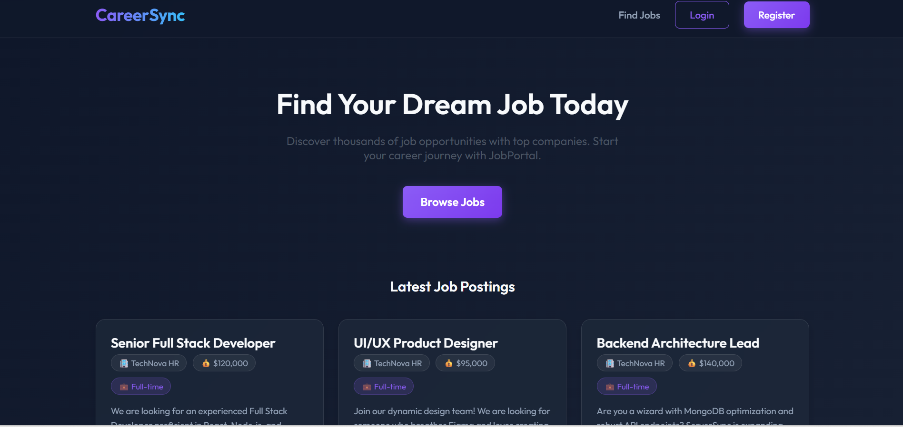
IMPLEMENTATION SCREENSHOTS
HOME PAGE
1
2
3
4
5
6
7
8
9
This is the main entry page of the Job Portal where users can navigate to login or sign up.
It provides an overview of the platform and allows users to explore job opportunities or get started.

Slide 12
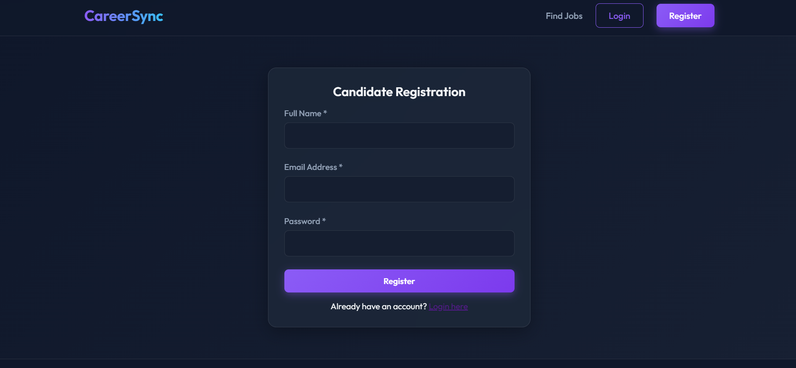
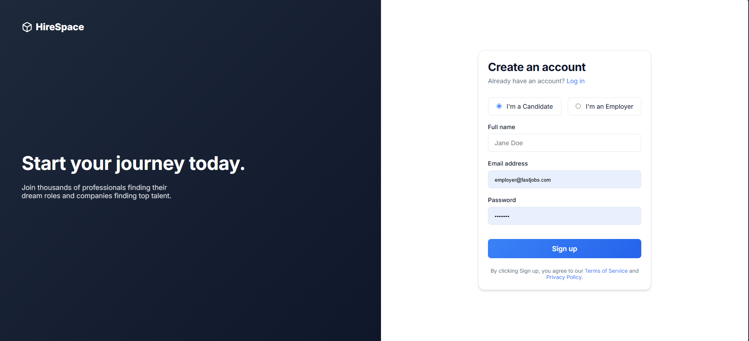
IMPLEMENTATION SCREENSHOTS
REGISTRATION PAGE
1
2
3
4
5
6
7
8(A)
9
• This page allows users or employer to create a new account by entering details like name, email, and password.
• It ensures secure user or employer registration and provides access to the job portal features after successful signup.

Slide 13
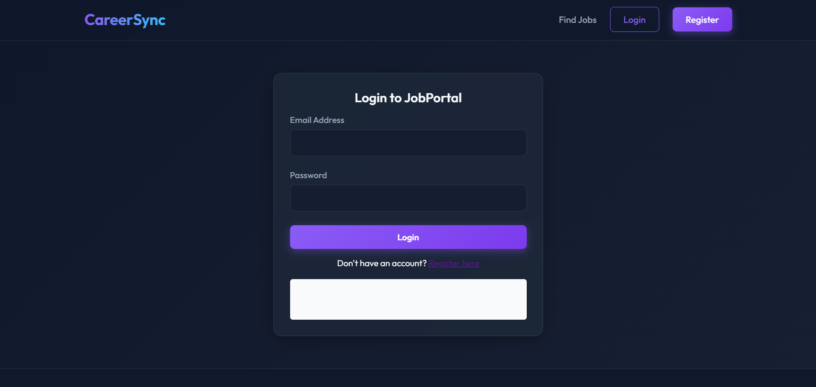
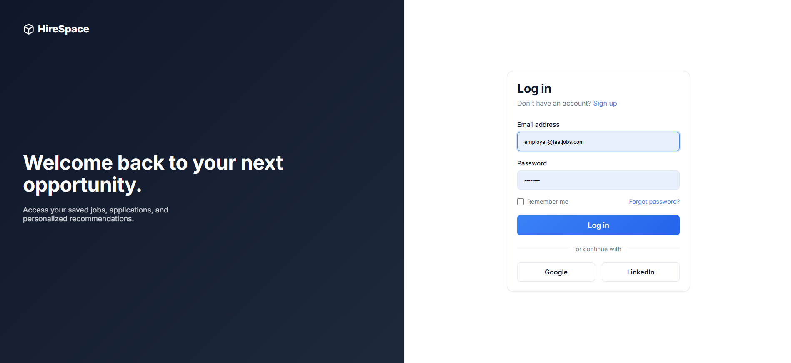
IMPLEMENTATION SCREENSHOTS
LOGIN PAGE
1
2
3
4
5
6
7
8(B)
• This page allows registered users or employers to log in using their email and password.
• It provides secure access to the system and redirects users to their respective dashboards after successful login.
9

Slide 14
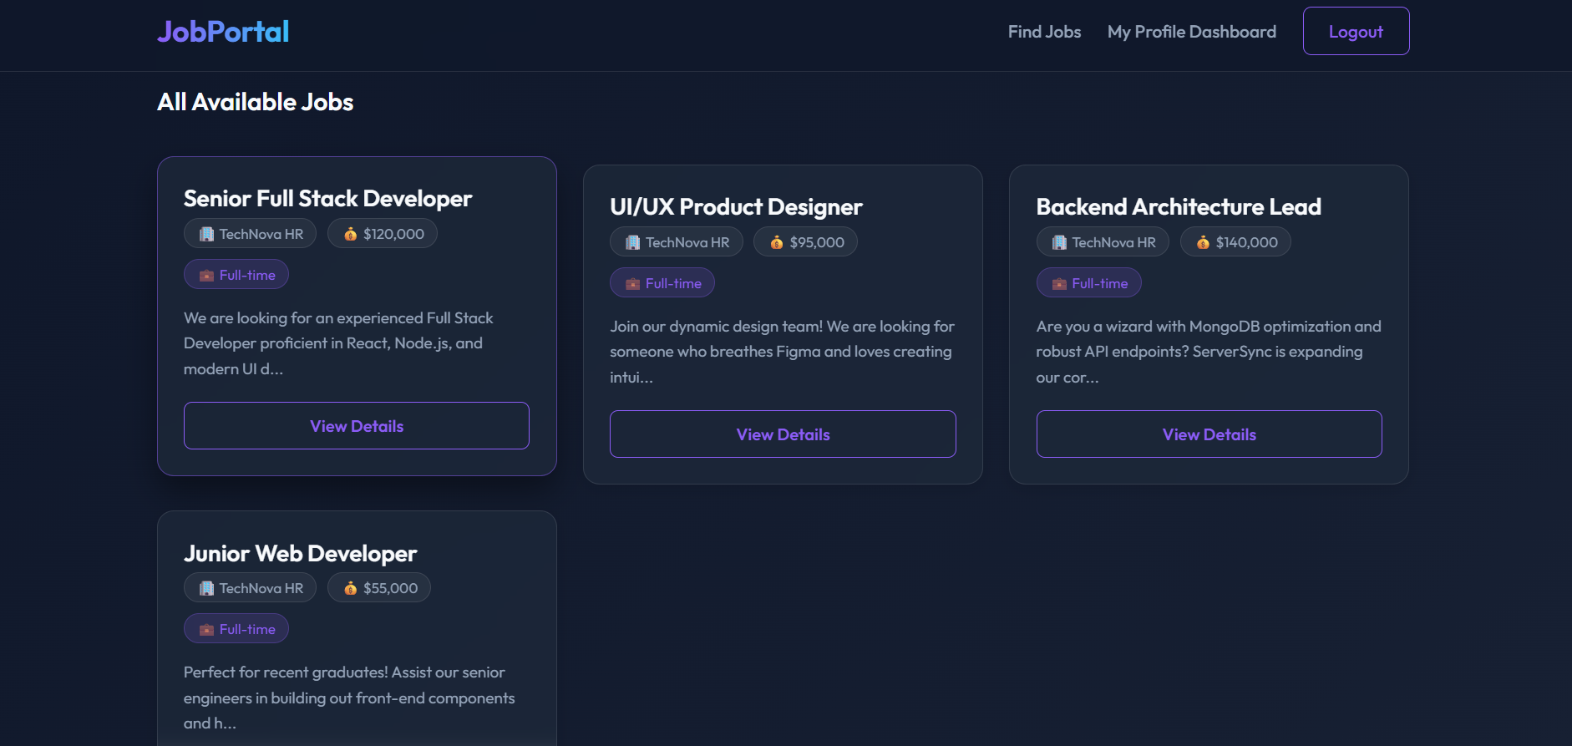
IMPLEMENTATION SCREENSHOTS
EMPLOYER JOB POSTING PAGE
1
2
3
4
5
6
7
8(C)
• This page allows employers to create and post new job vacancies by entering details like title, description, skills, and salary.
• It helps employers manage job listings and attract suitable candidates for recruitment.
9

Slide 15
IMPLEMENTATION SCREENSHOTS
JOB LISTINGS PAGE
1
2
3
4
5
6
7
8(D)
• This page displays available job opportunities with details like job title, company, skills, and salary.
• It allows users to search jobs and view detailed information before applying.
9

Slide 16
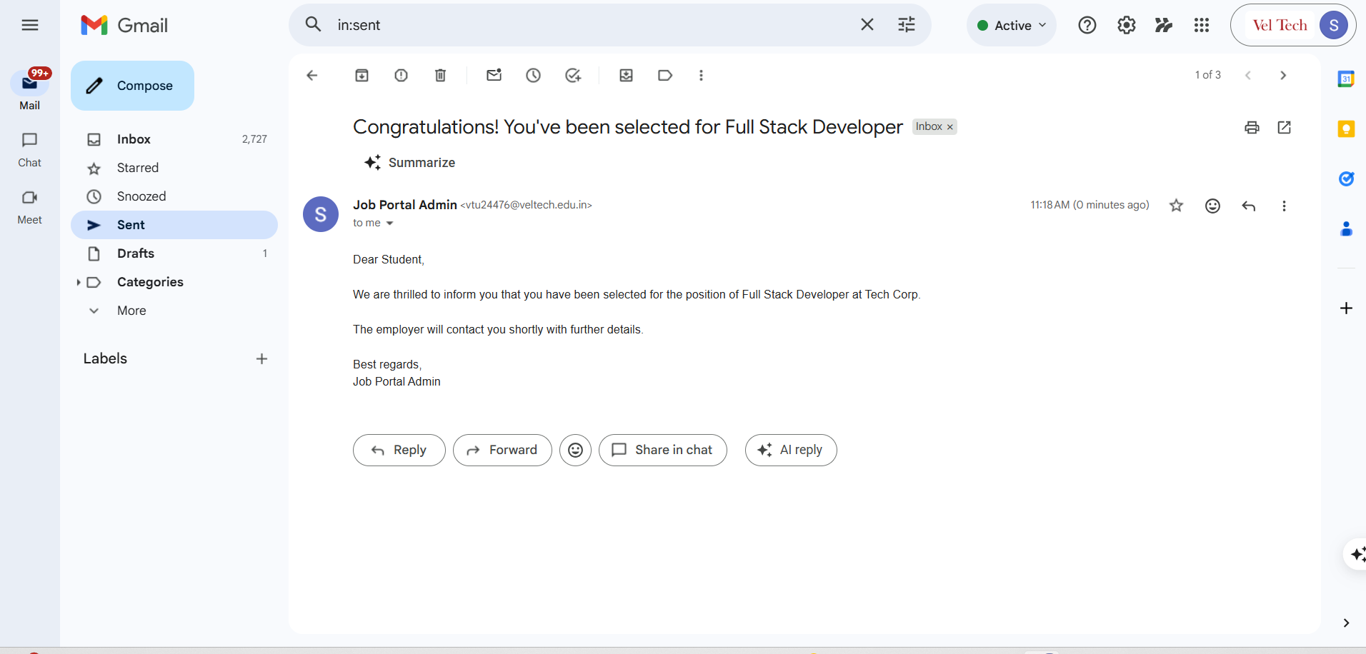
IMPLEMENTATION SCREENSHOTS
EMAIL NOTIFICATION
1
2
3
4
5
6
7
8(F)
• EmailJS API is used to send automated email notifications to users.
• It sends confirmation messages for job applications and status updates.
• This improves communication between job seekers and employers in real time.
9

Slide 17
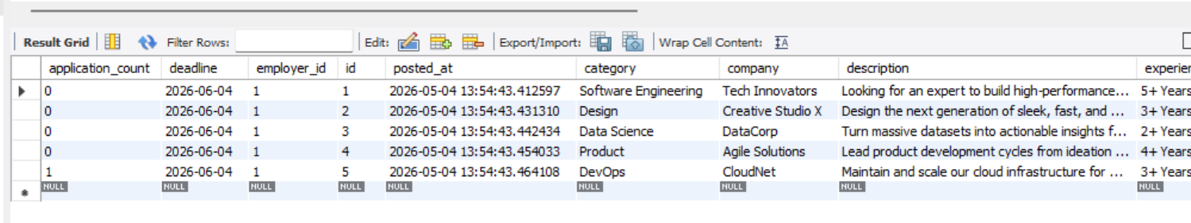
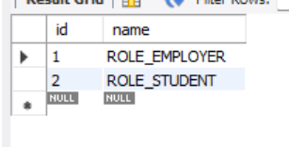
IMPLEMENTATION SCREENSHOTS
DATABASE
1
2
3
4
5
6
7
8(E)
• MySQL is used to store user, job, and application data in structured tables.
• Spring Data JPA manages database operations and relationships efficiently.
• The database supports secure storage and integrates with APIs for real-time updates.
9

Slide 18
ADVANTAGES & LIMITATIONS
1
ADVANTAGES:
• Reduces manual recruitment process and saves time. • Easy job search and application for users. • Employers can manage job postings and applicants efficiently. • Provides real-time application tracking and updates. • Centralized database ensures organized data management.
Limitations:
• Requires internet and system availability. • Basic security (can be improved with advanced encryption). • Depends on server availability (Spring Boot/MySQL).
2
3
4
5
6
7
8
9

Slide 19
Thank you

